Slide 1
SOC Amplify course
Briefing session
20 April 2023

Slide 2
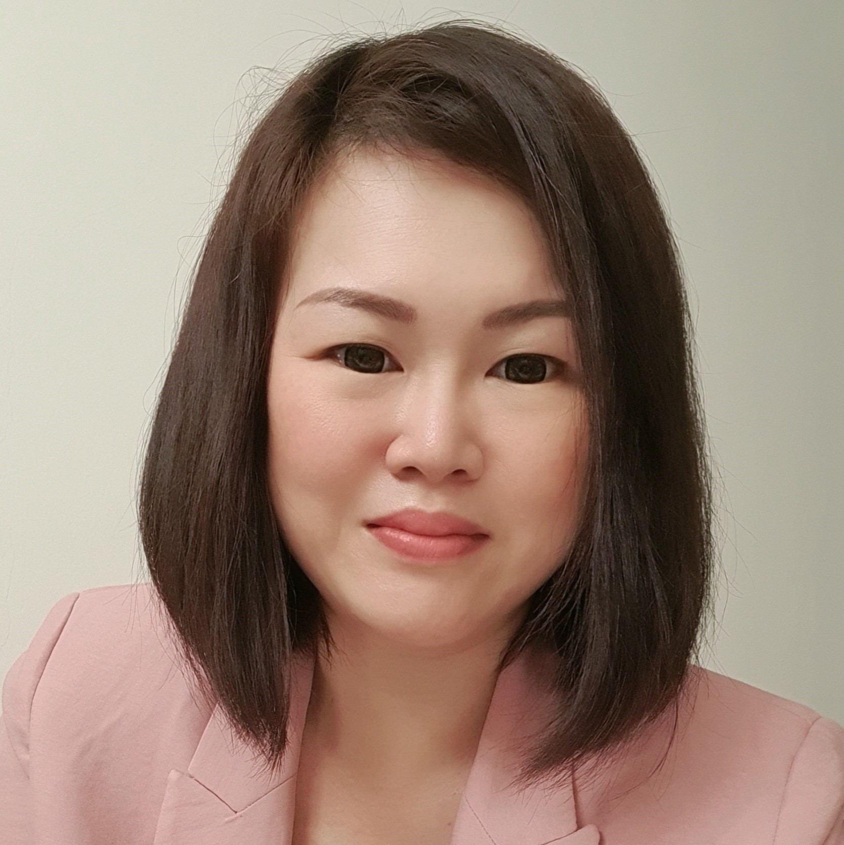
About Acronis
Trish Ng
Project Manager,
Acronis Cyber Foundation Program

Slide 3

Celebrating 20-year Anniversary

Slide 4
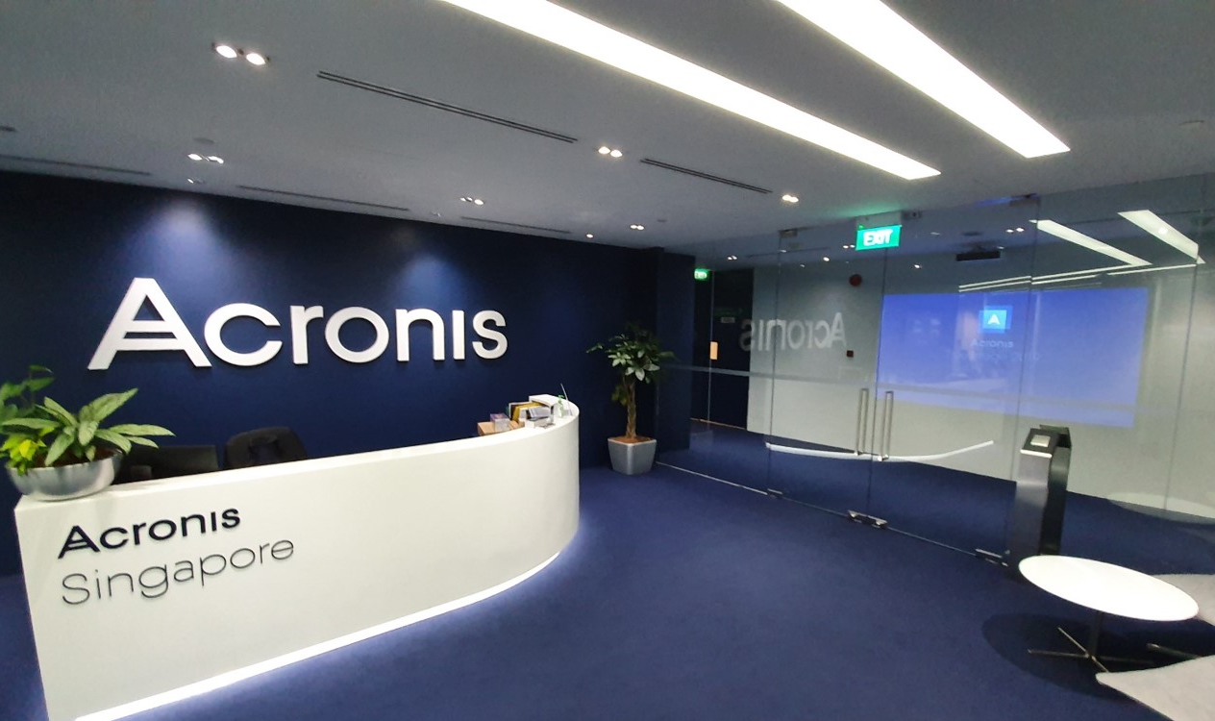
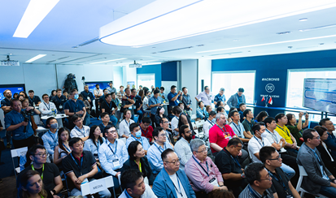
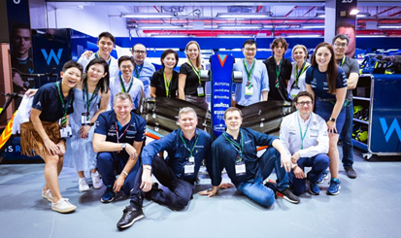
Acronis 20th Anniversary
Acronis founded in Singapore in 2003
Decades of
partnerships
Growing as one global Acronis team
Acronis was founded in Singapore in 2003, and has been headquartered in Schaffhausen, Switzerland since 2008.
Acronis products are built for service provider partners and supported in over 150 countries in 26 different languages
2,000+ total Acronis employees in 45+ countries around the world

Slide 5
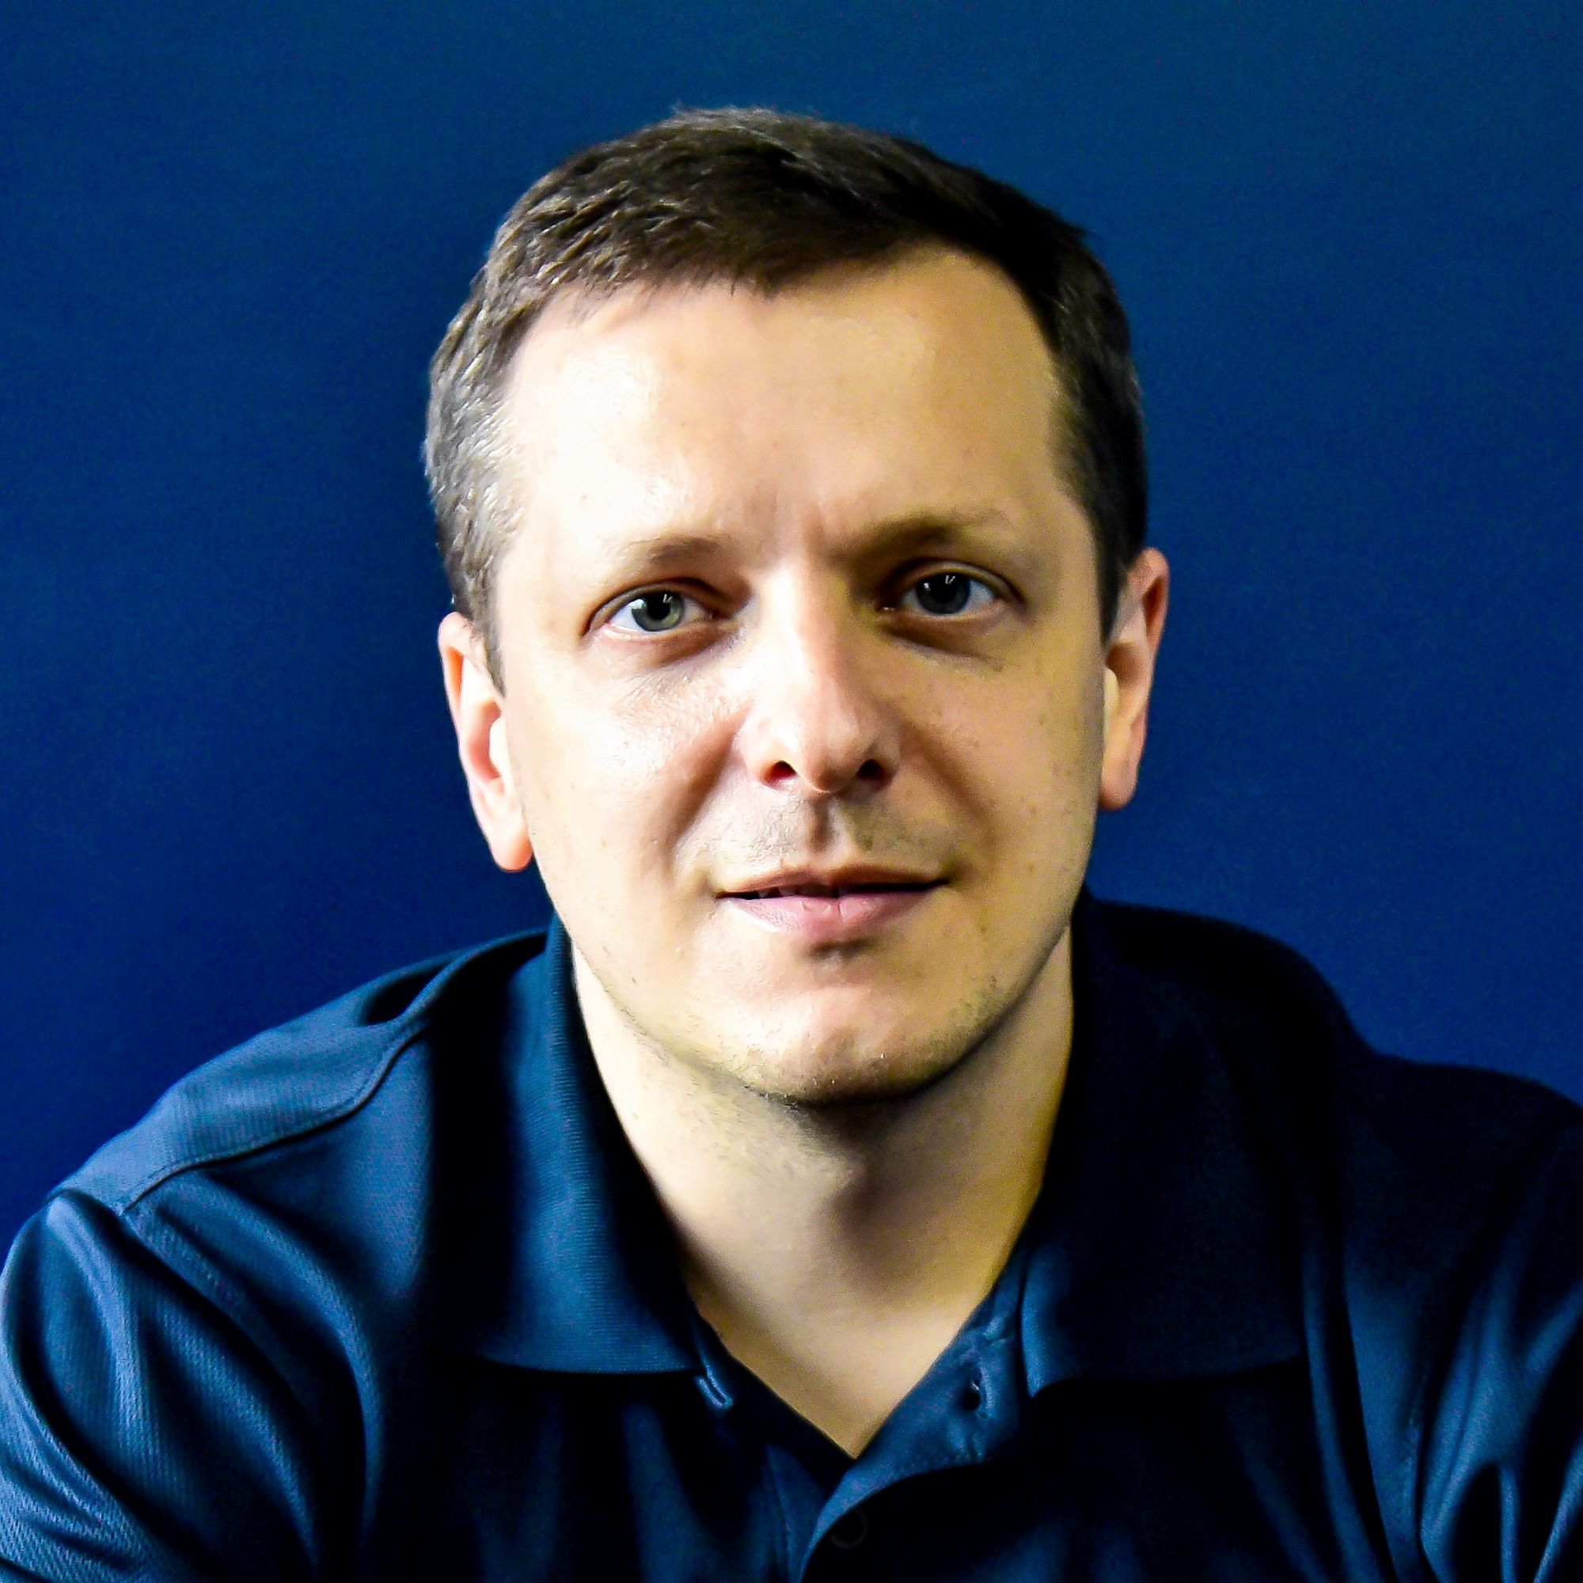
Course curriculum
Kevin Reed
CISO, Acronis
Notes:
Seasoned industry expert with more than 20 years of experience
Oversees our company’s security strategy and develops cutting-edge solutions
Leads Cyber Protection Operation Centers globally
Man of many talents, he is also a guest lecturer in local universities

Slide 6
What is SOC
What does SOC analyst do?
The function of the security operations center (SOC) is to monitor, prevent, detect, investigate, and respond to cyber threats in an organization.
SOC analyst is a role responsible for monitoring, detection and, sometimes, response to cyber security threats occurring in the organization. This is the core role of SOC function.
In order to be effective in this role, SOC analyst has to be familiar with a wide range of attack and defense techniques, computer network and systems architecture as well as be attentive to details, exercise critical thinking and being able to quickly react to changing cyber security landscape.

Slide 7
Curriculum overview
⠋
Foundations (4 hours)
⠍
Malware (10 hours)
Math refresher, boolean logic, computer architecture, assembly language and compiled languages overview.
How malware works. Binary vulnerabilities’ exploitation an application attacks. Malware detection and analysis. YARA.
⠕
Operating systems (20 hours)
⠙
DoS attacks (2 hours)
Operating systems architecture overview: Linux and Windows. Cloud computing foundations.
Kinds of DoS attack. DDoS dangers and response.
⠉
Cryptography (6 hours)
⠎
Social engineering attacks (2 hours)
Cryptographic algorithms and protocols. Passwords security, authentication. TLS, blockchains and bitcoin basics.
Spam, phishing, smishing and other kinds of social engineering attacks. Protections and response.
⠝
Computer networks (20 hours)
⠇
Cyber incident response (20 hours)
How the Internet works. Protocol foundations for Web browsing and email. Network attacks.
The problem of security monitoring. Attacks lifecycle and ATT&CK framework. Incident response practice.
⠺
Web and web attacks (10 hours)
⠓
Soft skills (6 hours)
Web architecture and infrastructure overview. Web 2.0 applications, attacks and defenses.
Crisis communication and escalation process. Critical thinking and continuous learning. Mental health.

Slide 8

Course prerequisites and requirements
No prerequisites.
No cost to participants.
For practical studies, participants will benefit from bringing
their laptops to class. If you don’t have a laptop, please
let us know.
We will provide a list of literature to supplement
and expand the course materials.

Slide 9


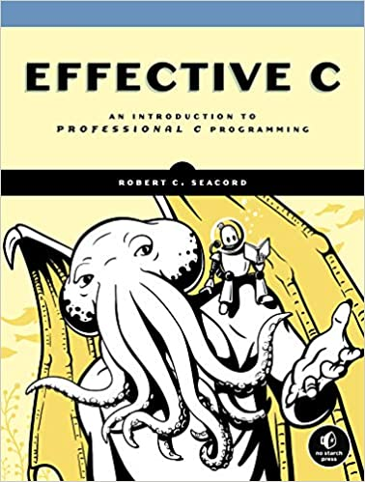


Supplementary Reading
How Computers Really Work
SGD 52.97 (Amazon)
The TCP/IP Guide
SGD 106.50 (Amazon)
Effective C
SGD 51.87 (Amazon)
Linux Basics for Hackers
SGD 43.63 (Amazon)
Practical Packet Analysis
SGD 61.95 (Amazon)
Notes:
Total cost - $316.92

Slide 10
Course timeline and format
This is off-line, in-person training. Minimum 80% attendance is expected.
We aim at 4 hours per week, twice a week, 25 weeks in total. Each class will start 7 p.m. in Acronis office.
There will be self-study assignments (non-graded), estimated effort 2 to 4 hours weekly.

Slide 11
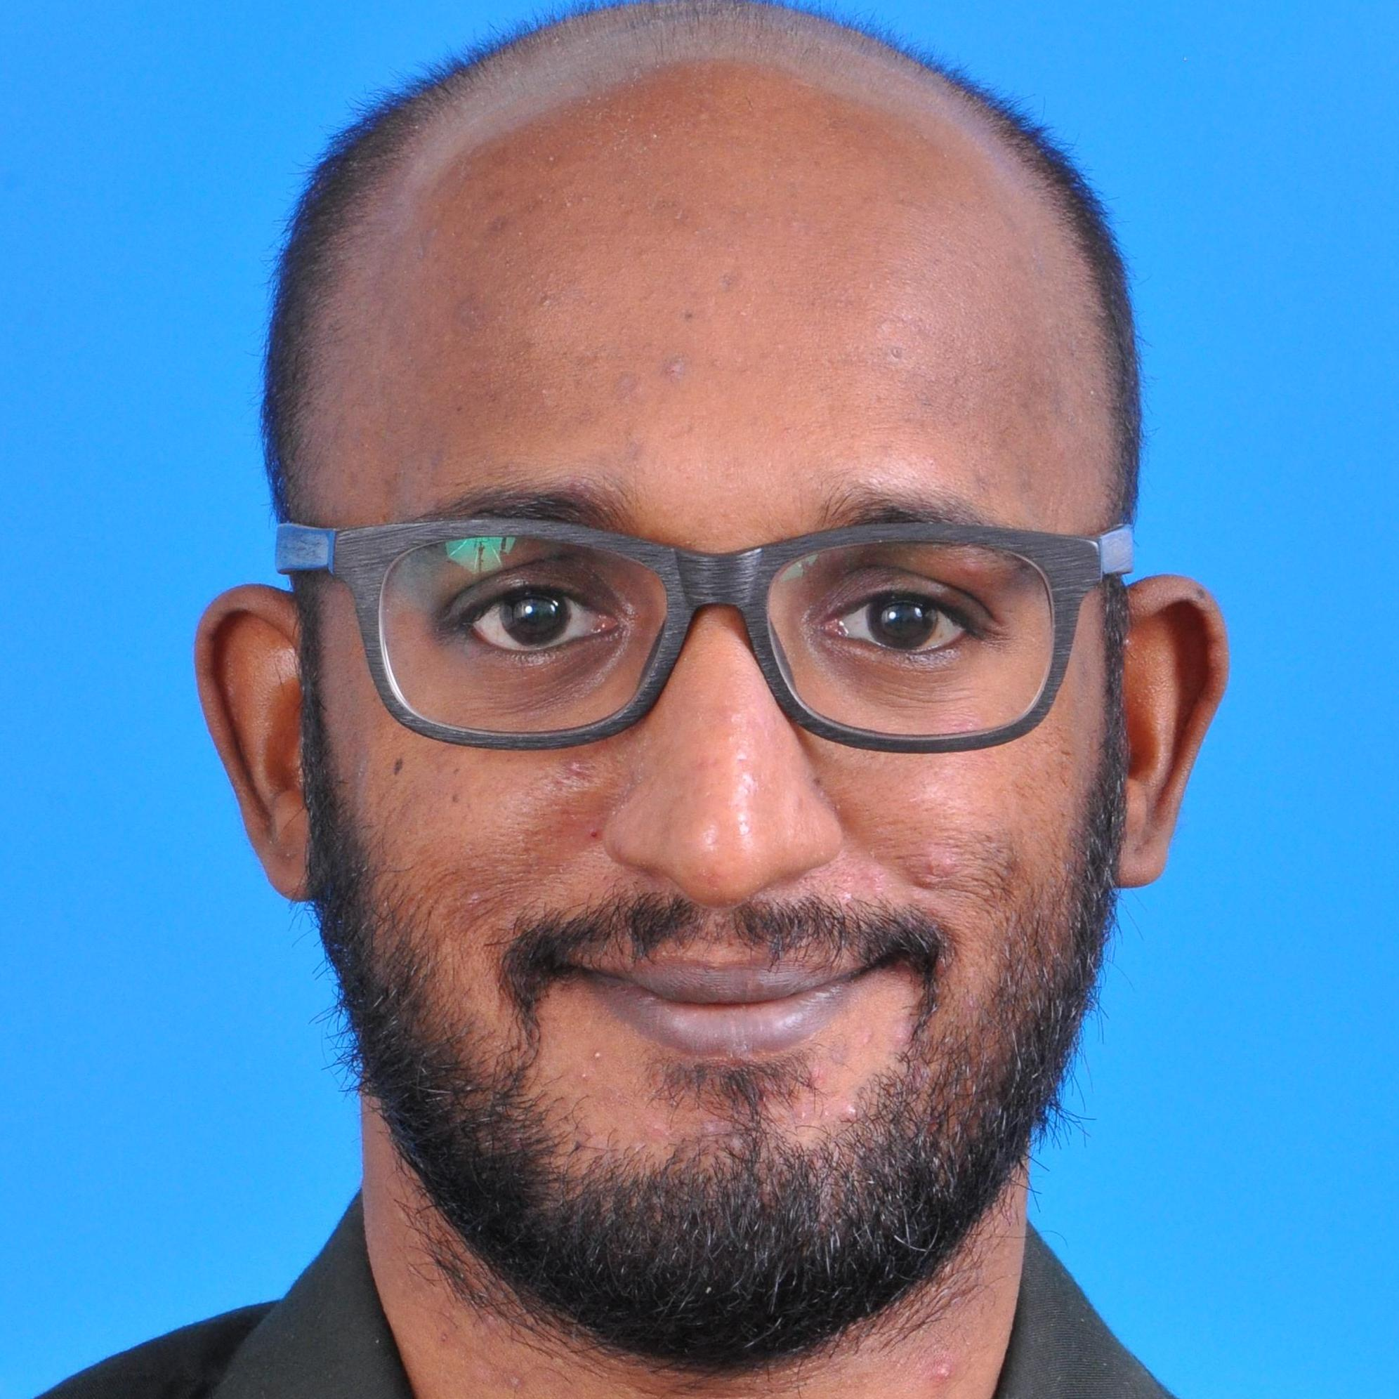
Tech journey
Prakas Thevendaran
Cybersecurity Researcher
Notes:
How did your tech journey start?
Cybersecurity Researcher from CPOC
Diploma in Microelectronics and Physics (TARC Malaysia), Bachelor of Science (Honours) Software Engineering
2015 Joined Bluecoat Systems In Kuala Lumpur,Malaysia as a Junior Malware analyst
Bluecoat KL -> Symantec KL -> Broadcom SG (2020) -> Acronis SG (2022)
When and why did you join Acronis?
2022
What are the challenges you think our industry faces?
The rise of cybercrime, which employs various techniques to gain unauthorized access to systems and steal data.
Advanced Persistent Threats (APTs) are another challenge as they remain undetected for a long time, making them difficult to prevent.
The industry also faces a lack of skilled professionals
Complexity in securing modern IT systems, and expanding attack surfaces due to new technologies such as cloud computing, mobile devices, and the Internet of Things (IoT)
Why should someone consider a SOC career?

Slide 13
Is there a fee to enroll into the course?
Notes:
Answer:
The pilot program is offered to participants as part of Acronis’ 20th anniversary this year.

Slide 14
Will there be any job/internship placement after the completion?
Notes:
Answer:

Slide 15
Is this course offered online or
in person classroom?
Notes:
Answer:
In-person for now, but sessions will be recorded for review

Slide 16
Will there be a certificate upon completion?
Notes:
Answer:

Slide 17
What are the skills and technical aptitude required in the market and the likely roles this training can offer?
Notes:
Answer:

Slide 18
Will BCP/DRP topics be included?
Notes:
Answer:
Yes
Business Continuity Plan (BCP) and Disaster Recovery Plan (DRP)
Business Continuity Plan (BCP) refers to a strategy or plan that encapsulates protocols that ensure that a business can maintain an operation level of business function even in a disaster.
Disaster Recovery Plan (DRP) is a strategy that outlines the process of resolving a disruption after the event has happened. DRP’s usually focus on finding the source of the issue, blocking it, recovering any lost data, and getting the business back up and running as soon as possible.
BCP encompasses all business functions needed to keep the business operational, no matter the type of crisis or event.
DRP focuses mainly on specific systems or data that has been impacted by the event and looks at restoring those affected as quickly as possible.

Slide 19
Will there be a segment on how to work effectively as a part of an SOC team in this course?
Notes:
Answer:

Slide 20
Inclusivity, open culture and
always aiming at excellence.
The ultimate goal is
sustainable professional preparation
and integration into the cybersecurity industry as SOC professionals.
The SOC Amplify Pedagogy

Slide 21

Ready to embark on your cybersecurity journey?
Sign up now!

